Slide 1
802.11 Networks:
hotspot security
Nguyen Dinh Thuc
University of Science, HCMC
ndthuc@fit.hcmus.edu.vn

Slide 2






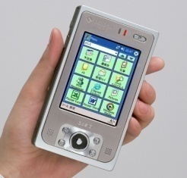

Introduction wireless LAN
Internet
Laptop
Wired LAN
10010101
Mobile
01010101
Access Point
Laptop
Wireless LAN
Pocket PC
Palm

Slide 3
Introduction wireless security
Privacy
Authentication
Availability
10010101
01010101
Integrity

Slide 4
Availability
Defending against Dis’ing attacks
Determining hot-IPs

Slide 5
Dis’ing attacks on 802.11 networks:
Introduction
In the current IEEE 802.11 standards, whenever a wireless station wants to leave the network, it sends a deauthentication or disassociation frame to the access point.
These two frames, however, are sent unencrypted and are not authenticated by the access point.
Therefore, an attacker can launch a DoS attack by spoofing these messages and thus disabling the communication between these wireless devices and their access point.

Slide 6
Dis’ing attacks on 802.11 networks:
Farewell attacks
To break the communication between STAs and their AP, an attacker can simply send out a spoofed deauthentication or disassociation frame.
There are a number of tool that enable an attacker to spoof the source MAC address of any device, such as: Spoof-MAC, Airsnarf, Mac Changer. Note that attacker spoofs a deauthentication or a disassociation frame of AP with broadcast destination MAC address, the effectively all STAs associated to the AP will be disconnected.
The Farewell attack is simple but can cause serious damage, because the attacker can stop the communication using only limited resources without requiring any special technical skill.
Bellardo et al. implement the attacks and show that this attack is simple and effective.
J. Bellardo and S. Savage. 802.11 Denial-of-Service attacks: real vulnerabilities and pratical solutions. In Proceedings of the 12th conference on USENIX Security Symposium, pages 18-25, Washington, DC, 2003.

Slide 7
Dis’ing attacks on 802.11 networks:
Some of Defending Solutions
Approach: eliminating the deauthentication and disassociation frames, or enqueueing them for a fix interval of time (for instance, 10 seconds)
Issues: there may be a period of time where a STA associates with multiple APs concurrently, which may cause routing/handoff problems
Approach: using Reverse Address Resolution Protocol (RARP) to detect spoofed frames
Issues: the attackers may spoof the IP address of the client to break the RARP.
Approach: detecting spoofed frames based on frame sequence number
Issues: the attacker may sniff the frames sent by the client to predict the sequence number of the next frame.
Approach: developing a lightweight authentication protocol for management frames, such as using 1 bit for authentication.
➔ Issues: errors in wireless medium may break the authentication, and the probability of an attacker to guess the authentication bit correctly is high (50%)

Slide 8
Dis’ing attacks on 802.11 networks: letter-envelop protocol
The protocol works based on a one-way function f(.): given y = f(x), it is computationally infeasible to compute x; However, given x, it is easy to compute N. The Letter-envelop protocol is as follows:
Initially, STA randomly generates x₁, then computes y₁ = f(x₁). Similarly, AP generates x₂ and computes y₂ = f(x₂).
During the authentication process between STA and AP, STA sends y₁ to the AP, and AP sends y₂ to the STA.
When the STA wants to disconnect from the AP, it sends either the deauthentication or the disassociation frame to the AP, together x₁ to the AP. If f(x₁) = y₁ then the frame is authenticated and will be procceed accordingly. Otherwise, the frame is rejected.
Similarly, if the AP wants to disconnect from the STA, it sends the disassociation/deauthentication frame together x₂. The STA disconnects itself from the AP if f(x₂)=y₂.

Slide 9
Dis’ing attacks on 802.11 networks: letter-envelop protocol
STA −−−−−→ AP Connection process |  | STA −−−−−→ AP Connection process |  |  | STA −−−−−→ AP Connection process
Authentication |  | Authentication |  |  | Authentication
Association | Generate x₁ y₁ = f(x₁) | y₁ −−−−−−−−−−−→ y₂ ←−−−−−−−−−−− | y₂=f(x₂) is already computed | Ass. request | Generate x₁ Compute y₁=f(x₁) y₁ −−−−−−−−−−−−−→
Data exchange |  | Data exchange |  |  | Generate x_{i} Compute y_{i}=f(x_{i}) y₂ ←−−−−−−−−−−−−−
(a) Original Association |  | (b) Modified Association |  |  | (c) Modified Association (special case)
Thuc D. Nguyen, Duc H. M. Nguyen, Bao N. Tran†,Hai Vu, Neeraj Mittal, A lightweight solution for defending against de-authentication/disassociation attacks on 802.11 networks, In IEEE 17th International Conference on Computer Communication and Networks (ICCCN), St. Thomas, US Virgin Islands, August 2008

Slide 10
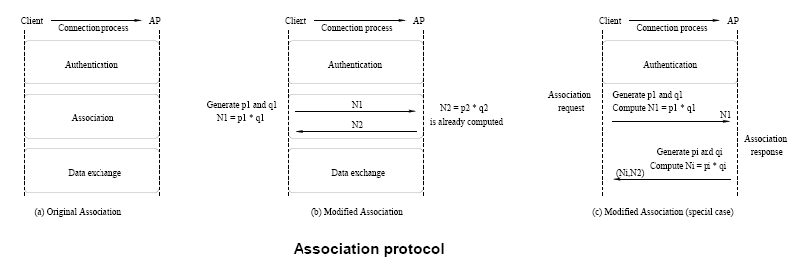
Dis’ing attacks on 802.11 networks: implementation of letter-envelop protocol
Thuc D. Nguyen, Duc H. M. Nguyen, Bao N. Tran†,Hai Vu, Neeraj Mittal, A lightweight solution for defending against de-authentication/disassociation attacks on 802.11 networks, In IEEE 17th International Conference on Computer Communication and Networks (ICCCN), St. Thomas, US Virgin Islands, August 2008

Slide 11
Dis’ing attacks on 802.11 networks: implementation of letter-envelop protocol
The configuration of our system is as follows:
One PC (CPU: Intel Celeron 3GHz, RAM: 1GB, HDD: 80GB) functioning as an AP.
One PC (CPU: Intel Celeron 1.73GHz, RAM: 512MB, HDD: 80GB) functioning as a legitimate STA. this STA continuously sends ICMP ping packets to the AP to check the connection with the AP.
One PC (CPU: Intel Core Duo 1.6GHz, RAM: 512MB, HDD: 80GB) running CommView for Wifi to launch the Farewell attack.
We continuously send deauthentication and disassociation frames with spoof MAC address of the STA (to the AP) and of the AP (to the STA) at rate 10 frames/second. If AP can detect the frame to be a spoofed frame, they will ignore the frame and will not disconnect the STA. otherwise it will disconnect the STA and clear information related to that STA in the memory.
The result of the experiments show that our solution is completely effective against the Farewell attack, none of the attacks is successful.

Slide 12
Availability
Defending against Dis’ing attacks
Determining hot-IPs

Slide 13
Computing heavy hittes
Cormode and Muthukrishnan consider the following problem of determining “hot items" or "heavy-hitters.“ in a given sequence of items from [n], an item is considered hot" if it occurs > m=(d + 1) times; where d is a given constant.
Note that there can be at most d hot items.
G. Cormode and S. Muthukrishnan. What's hot and what's not: tracking most frequent items dynamically. ACM Trans. Database Syst., 30(1):249{278, 2005.

Slide 14
Algorithm of Cormode-Muthukrishnan
Cormode and Muthukrishnan proposed an algorithm based on Non-Adaptive Group Test (NAGT) that computes all the hot items as long as the input satises the following “small tail” property: all of the non-hot items occur at most m=(d + 1) times.
Let M be a d- disjunct t×n matrix. For each test i ∈ [t], maintain a counter c_{i}. When an item j ∈ [n] arrives (leaves respectively), increment (decrement respectively) all the counters c_{i} such that M_{ij} = 1. The algorithm also maintains the total number of items m seen so far.

Slide 15
Disjunct-matrix
A binary t×N matrix is said to be d-disjunct if the union (or Boolean sum) of any d columns does not contain any other column.

Slide 16
Determining hot-IPs
Let n be number of IP address and d be maximum number of IPs which can been attacked.
Given a sequence of IPs, the problem is to find those IPs which occur most frequently. This is formalized as finding all IPs whose frequency exceeds a specified fraction of the total number of IPs.
This problem can been solved by using group test method

Slide 17
Algorithm
Let
M be d-disjunct t×n matrix
C := (c₁,…,c_{t})∈N^{t}
R:=(r₁,…,r_{t})∈{-,+}^{t}
IP∈[n]*: sequence of IPs.
For j=1 to t do c_{j}=0
For each i∈IP,
for j=1 to t do
if m_{ij}=1 then c_{j}++
For j=1 to t do
  If c_{j}>d then r_{j}=+
  Else r_{j}=-

Slide 18
Example

Slide 19
Determining hot-IPs
Given R∈{-,+}t
Find hot-IPs
With each r_{i}=- do
for i=1 to n do
if (m_{ij})=1 Then
IP:=IP\{j}
Return IP

Slide 20
Example

